Slide 1
How Technology Shapes Campaign Strategy and Tactics

Slide 2
Agenda
12:00–12:15 Welcome, framing & session model
12:15–12:45 Worked example: Honour the Offer
12:45–13:05 Groups form & campaign choice
13:05–13:50 Sense-making: goals, power & decision-makers (incl. Goal & decision check)
13:50–14:00 Break
14:00–14:55 Tactics & pressure (incl. Power & pressure check)
14:55–15:25 Organising people
15:25–15:55 Completing plans
15:55–16:25 Group share-back & critique
16:25–16:45 Synthesis & reflection
16:45–17:00 Close

Slide 3
Sense-making
Sense-making is the work of understanding the situation you are in before you act. It’s about turning a messy political problem into something you can make decisions about.
In campaigning, sense-making means
Clarifying what decision you are trying to change
Identifying who actually holds power over that decision
Understanding how decisions are made in practice, not just on paper
Spotting risks, constraints, and moments of opportunity
How technology might help campaigns:
research institutions and decision-makers
map relationships and influence
analyse data, patterns, and precedents

Slide 4
Tactics & pressure
Tactics and pressure are about changing the incentives of decision-makers so that maintaining the status quo becomes more costly than changing course.
In campaigning, sense-making means
Choosing actions that create real consequences
Applying pressure where it actually lands
Sequencing actions so pressure builds over time
Matching tactics to the risks decision-makers care about
How technology might help campaigns:
amplify
coordinate actions quickly
package and present evidence
scale pressure through new channels

Slide 5
Organising people
How do you get people to do something to enact your tactics to apply pressure.
In campaigning, sense-making means
Recruiting people into action
Building relationships and trust
Creating structures that let many people act together
How technology might help campaigns:
reduce friction in coordination
make participation easier
keep people connected over time
Track metrics and progress

Slide 6
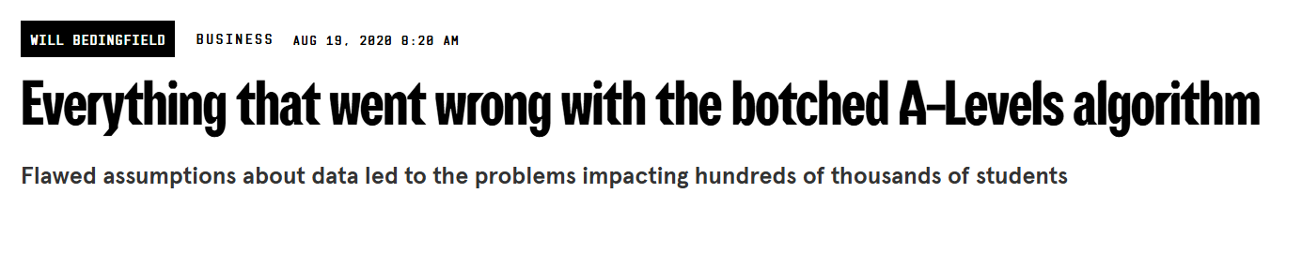
Example #HonourtheOffer

Slide 7
Sense-Making
Others handling national pressure
Pick scope - Oxford University
They have enough money to reverse this decision
They will be more sensitive to disadvantages and unfairness
Decentralised decision making - at each college means easier to target, if one falls they all will.
Oxford Living Wage ->Go after the alumni
No Tech Needed….

Slide 8
2. Tactics and Pressure
Go after the alumni -> so use personal networks social media is a gift
Public pressure as sensitive to not helping poor kids -> so Twitter hashtag and news hook strong retweet game as media on it
Pit them against each other publicly - college system -> so create league table Google sheets

Slide 9
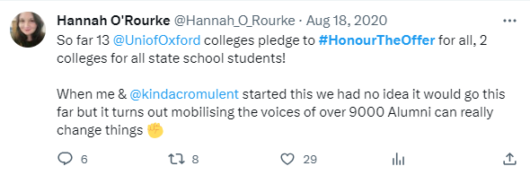

Slide 10
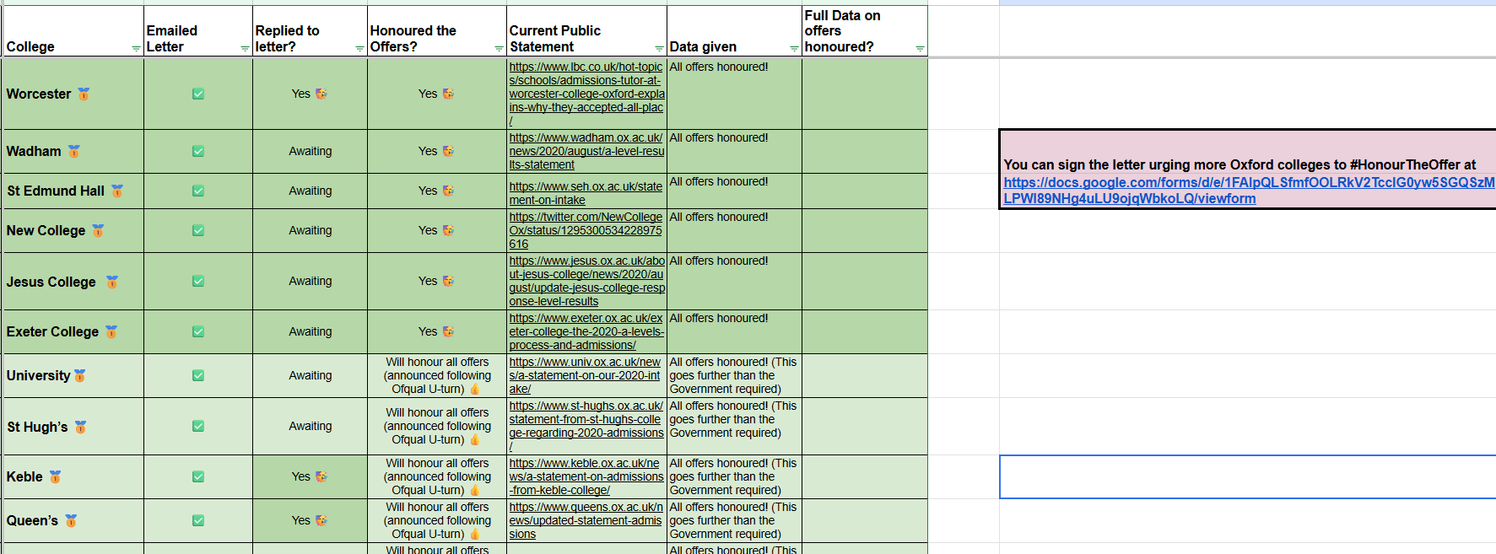
Where are the colleges up to?

Slide 11
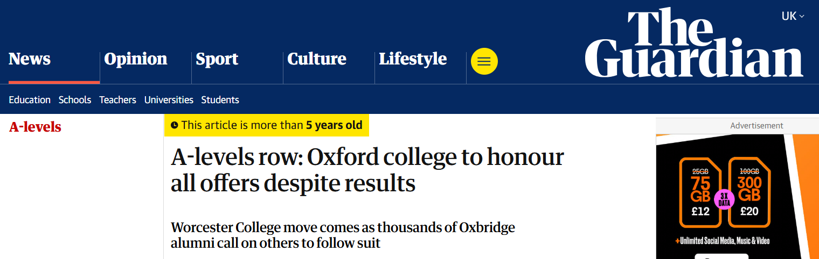
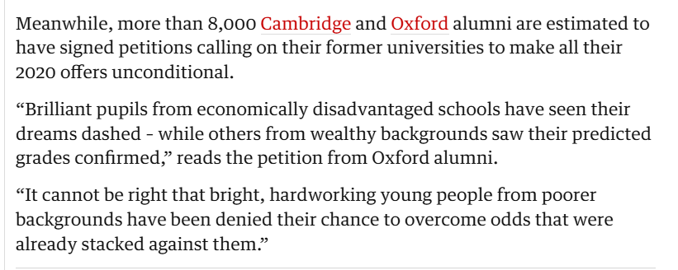

Slide 12
3. Organising People
Needs to spread fast and be easy to do -> google form
Public recognition for signing -> Open letter
Get alumni -> so Network effects so use whatsapp/ Facebook groups and one to one messages to seed, hit threshold to explode it
Replicable by other people -> copyable format

Slide 13


Networks

Slide 14
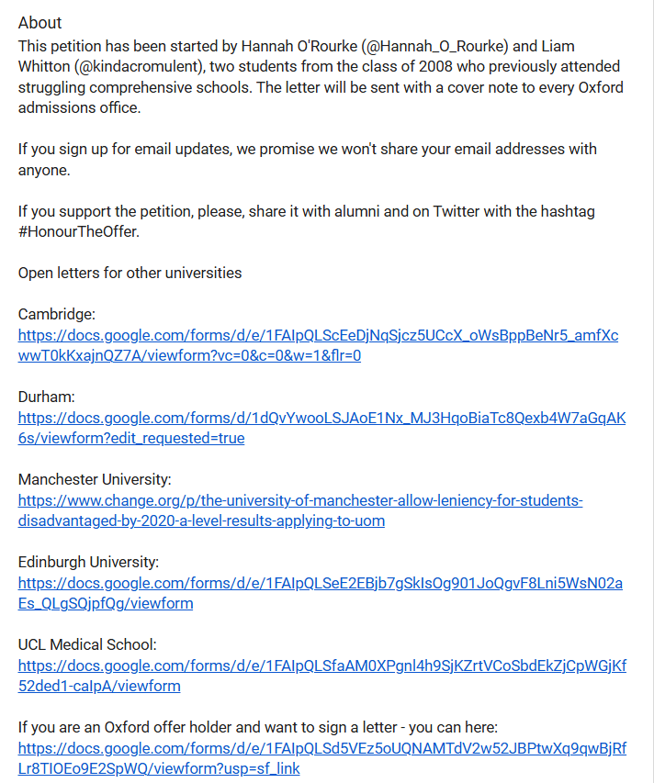

https://docs.google.com/forms/d/e/1FAIpQLSfmfOOLRkV2TcclG0yw5SGQSzMLPWl89NHg4uLU9ojqWbkoLQ/viewform

Slide 15
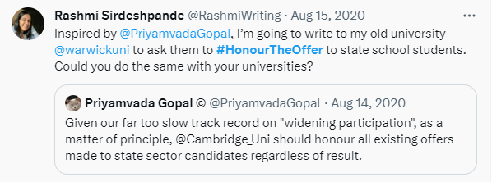

Slide 16

What Tech Helps at each stage? (Examples)
Sense-making
Council Minutes Tracker
Democracy Club data with councillor contact details
My Society/ Theyworkforyou
Tactics and Pressure
Directory of local facebook groups
Constituency Explorer
Asylum Changes
Organising People
Rep coach
Chathackers
Whatsapp sharer
Action Network

Slide 17
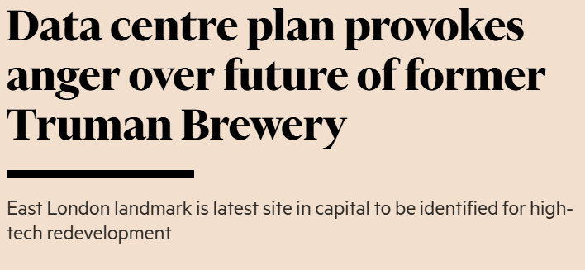
Stop the Data Centre on Brick Lane
A proposal has been made to redevelop part of the historic Truman Brewery site into a large data centre that many local residents oppose.

Slide 18
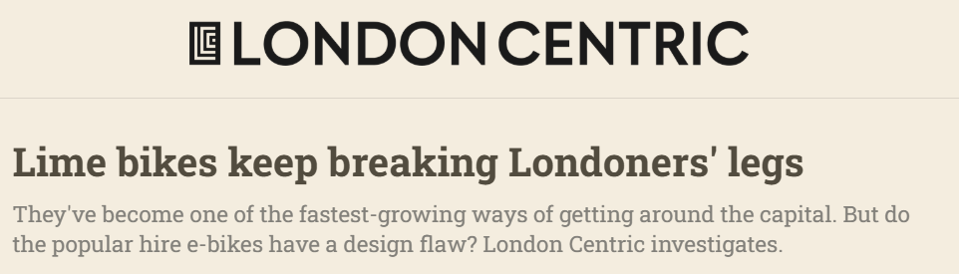
Stop Faulty Lime Bikes
Dockless Lime e-bikes are widely used in London, but they are causing serious injuries linked to brake failures.

Slide 19
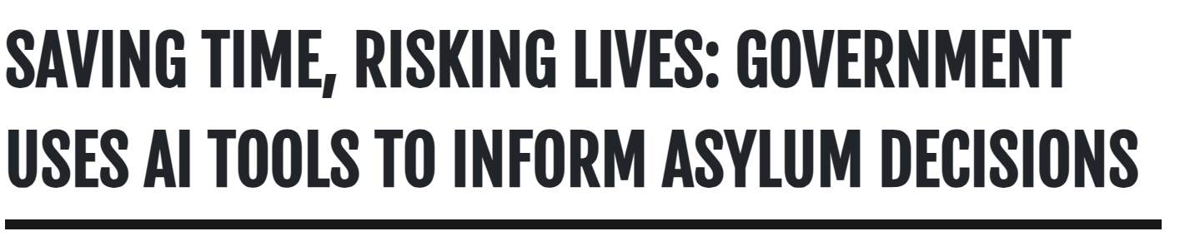
Stop Use of Automated Decision-Making in UK Visa Cases
Automated decision tools are increasingly used by the Home Office in visa decisions, raising fairness concerns.

Slide 20
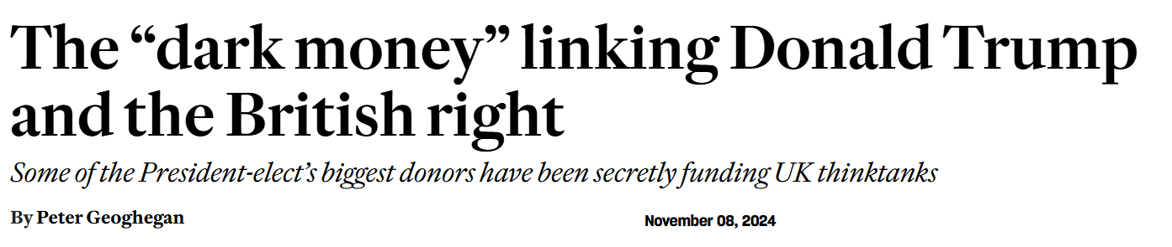
Stop UK far right groups from receiving US funding
Concerns have been raised about UK far-right groups receiving funding or support linked to Trump-aligned networks.

Slide 21
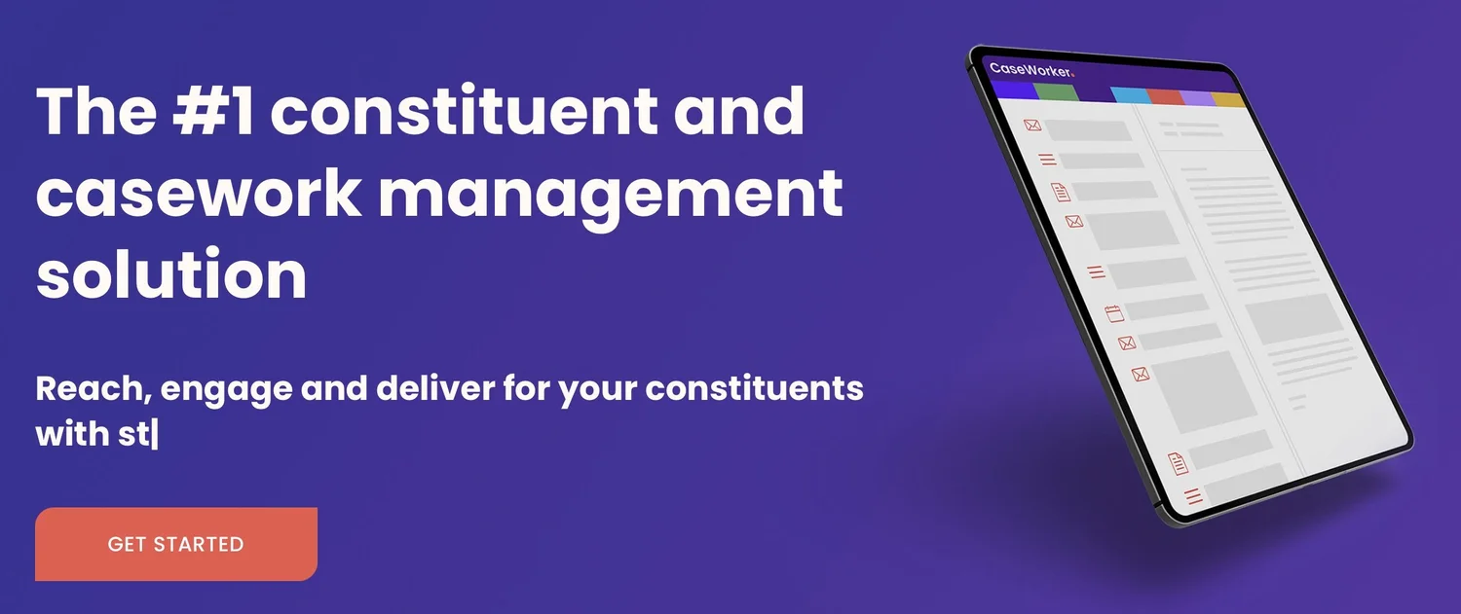
Open up parliament’s digital services
Create an approval process for new tech tools for parliamentarians to fight caseworker’s monopoly.

Slide 22
Stage 1: Sense-making (goals & power)
What decision are we trying to change?
Who actually decides?
Are there multiple decision makers?
Where will pressure work?
What is the smallest viable win?
Name the meeting / office
Name the decision-maker
Timeframe
Minimum acceptable outcome
What data, research, or mapping would help us understand this better?
https://bit.ly/mappol
What don’t we know yet?
How could technology help with this?

Slide 23
Some Methodologies
Power Mapping https://commonslibrary.org/power-mapping/
Theory of Change https://media.nesta.org.uk/documents/Theory_of_change_worksheet.pdf
Minimum Viable Win
SMART Goals https://en.wikipedia.org/wiki/SMART_criteria
https://commonslibrary.org/campaign-strategy-start-here/

Slide 24
⏰Check In
“We want [decision-maker] to [specific action] by [time], even if the outcome is only [limited win].”

Slide 25
Stage 2: Tactics & pressure
What will influence this decision-maker?
What pressure do they respond to?
What risks do they avoid? Electoral / reputational / internal / legal
Who else can apply pressure?
What tactics might work?
Who needs to apply them and at what scale?
What channels might you need?
How might technology:
enable new tactics?
strengthen existing ones?
increase the cost of ignoring the issue?
What resources do I have?

Slide 26
Methodologies
Decide on pressure
Power/ Influence mapping https://rethinkeconomics.org/group-guidelines/power-mapping/
Pillars of Power https://commonslibrary.org/pillars-of-power/
Decide on Tactics
List of tactics https://commonslibrary.org/topic/tactics/ , https://activisthandbook.org/tactics
Work out Resources/ Resource Mapping
Stakeholder Mapping https://activisthandbook.org/strategy/stakeholders
Networks
Team
Allies
Opponents
Physical resources
Technological resources

Slide 27
⏰Check In
Each group answers:
Who matters most to move the decision?
What pressure moves them?
What tactics will you use to move them?
What resources will you use?

Slide 28
Stage 3: Organising People
Who needs to act?
What are you asking them to do?
How do you sustain participation?
What limits people from taking action?
What are the blockers?
What would increase capacity?
How do you sustain motivation?
How does tech reduce friction in:
coordination?
motivation?
Follow-up?
Reaching people?
What would break without tech?
What channels might you use to coordinate people?

Slide 29
Methodologies
Relational organising https://commonslibrary.org/how-to-do-relational-organizing-video-tip-sheet-and-work-sheet/
One-to-one conversations https://commonslibrary.org/organizing-people-power-and-change-the-one-on-one-meeting/
Lobbying https://docs.google.com/document/d/1l0n2M0nNDo6_naA3ZCVJWBwHcue0ZfCm/edit?rtpof=true&tab=t.0
Ladder of engagement https://actionnetwork.org/forms/download-the-ladder-of-engagement-worksheet?nowrapper=true&referrer=&source=direct_link
Coalition building https://www.local.gov.uk/publications/12-components-effective-coalitions
Mass mobilisation/ digital mobilisation https://forwardaction.uk/2025/01/digital-mobilisation-predictions-for-2025-movement-innovation-and-impact/
Distributed Organising https://commonslibrary.org/how-to-guide-distributed-organizing-2/
Community Building https://activisthandbook.org/organising/community-building/
Membership https://membershipguide.org/handbook/getting-started-with-membership/discovering-our-value-proposition , 🌹Labour Membership Mobilisation Guide
Movement building https://growingthegrassroots.civicpower.org.uk/chapters/lessons-on-organising-and-movement-building

Slide 30
⏰Check In
Complete your plans and present them back!

Slide 31
Reflection: Have you got any ideas for meta tech tools?
What would have made your jobs easier at each stage?
What could be reusable across campaigns?

